Slide 1

Student Management System
Presented By:-
1) Vaishnavi Jadhav
2) Neha Sawant
3) Pooja Chavan
4) Rupali Khairnar
5) Sima Jadhav

Slide 2
INTRODUCTION
The Student Management System can handle all the details about a Student .
The details include Course details,Student personal details etc.
The Student Management System is an automated version of manual Student Management System.

Slide 3
PROJECT OBJECTIVE
Student management system is a management information system for education establishments to manage student data.
It provides capabilities for registering students in courses, inserting, update, deleting the data.

Slide 4
TECHNOLOGIES USED
Spring Boot
Postman
MySQL

Slide 5
MySQL
MySQL creates a database for storing and manipulating data, defining the relationship of each table. Clients can make requests by typing specific SQL statements on MySQL. The server application will respond with the requested information and it will appear on the clients' side. MySQL works with an operating system to implement a relational database in a computer's storage system, manages users, allows for network access and facilitates testing database integrity and creation of backups. MySQL is ideal for both small and large applications.
Postman
Postman is an API client that makes it easy for developers to create ,share, test and document APIs. With this open-source solution, users can create and save simple and complex HTTP/s requests, as well as read their responses. When you are signed into your account, you are able to access your files. You can execute Postman API tests anytime, anywhere.Postman is very convenient when it comes to executing APIs. Once you’ve entered and saved them, you can simply use them over and over again, without having to remember the exact endpoint, headers, or API keys.
Spring Boot
Spring Boot is a java framework used for develop standalone application. Need strong knowledge in OOPS & Java concept then only working with spring framework.Mostly all applications are developed by spring boot. Because it was very secure no one hack the information. Spring Boot is an open source Java-based framework used to create a micro Service. It is developed by Pivotal Team and is used to build stand-alone and production ready spring applications.

Slide 6
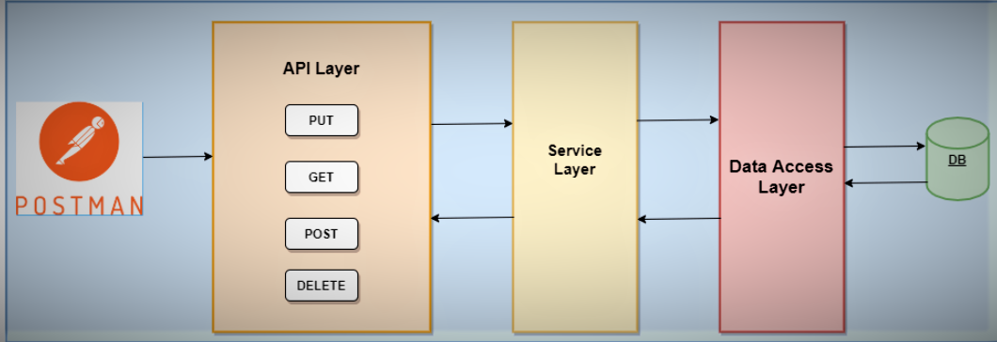
Postman Architecture

Slide 7
REQUIRED SPECIFICATION
Hardware Configuration | Software Configuration
Operating System : Windows 10 | Software IDE : Spring Boot
Hard Disk : 1 Tb | Language : Java
RAM 8 : 8GB | MySQL server, Postman

Slide 8
ANNOTATIONS
@SpringBootAplication :- This annotation is used to mark the main class of a Spring Boot application.
@Autowired :- @Autowired annotation is applied to the fields, setter methods, and constructors . We use @Autowired to mark the dependency that will be injected by the Spring container.
@GetMapping :- It maps the HTTP GET requests on the specific handler method. It is used to create a web service endpoint.
@PostMapping: It maps the HTTP POST requests on the specific handler method. It is used to create a web service endpoint.
@PutMapping annotationAnnotation for mapping HTTP PUT requests onto specific handler methods. Specifically,
@DeleteMapping: It maps the HTTP DELETE requests on the specific handler method. It is used to create a web service endpoint that deletes a resource

Slide 9
@Entity :- The @Entity annotation specifies that the class is an entity and is mapped to a database table.
@Id :- The @Id annotation specifies the primary key of an entity.
@Column :- @Column annotation is used for Adding the column the name in the table of a particular MySQL database.
@OneToMany :- one-to-many mapping means that one row in a table is mapped to multiple rows in another table.
@GeneratedValue :- The @GeneratedValue annotation provides the specification of generation strategies for the primary keys values.
@ManyToOne :- By using this annotation, we are letting Spring Data JPA know that this is a join with a many to one relationship.
@Repository :- annotation is used to indicate that the class provides the mechanism for storage, retrieval, search, update and delete operation on objects.
@Service :- annotation is used with classes that provide some business functionalities.
@RestController: It can be considered as a combination of @Controller and @ResponseBody annotations. The @RestController annotation is itself annotated with the @ResponseBody annotation. It eliminates the need for annotating each method with @ResponseBody.

Slide 10

Use Case Diagram
StudId
FirstName
LastName
Email
Password
CourseId
Course
Student
CourseName
Learner
Fees
Id
Rating
Review
Description

Slide 11
CLASS DIAGRAM
Student
Course
Review
Stdid : Integer
FirstName : String
LastName : String
Email : String
Password : String
CourseId : Integer
CourseName : String
Learner : String
Fees : String
Id : Integer
Rating : String
Description : String
AddCourse()
UpdateCourse()
DeleteCourse()
AddReview()
UpdateReview()
DeleteReview()
AddStudent()
UpdateStudent()
DeleteStudent()

Slide 12
ER Diagram
Studid
CourseId
FirstName
CourseName
Email
Student
LastName
Course
Learner
Password
Have
Fees
Review
id
Rating
Description

Slide 13
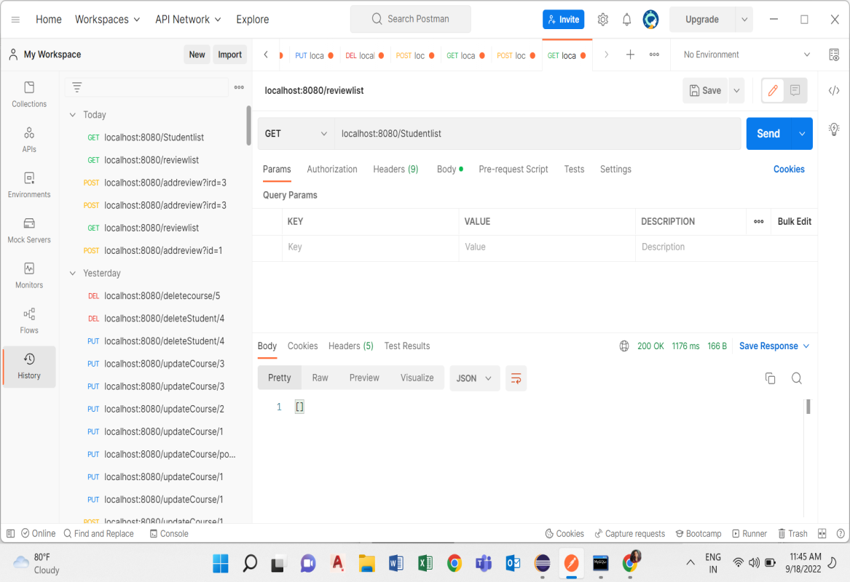
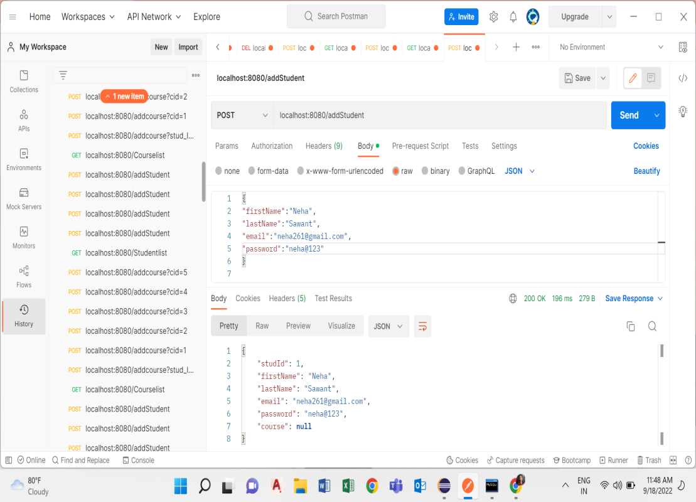
OUTPUT SCREENSHOTS

Slide 14
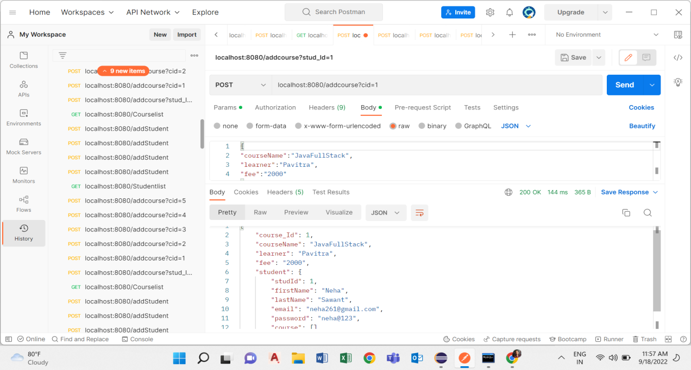
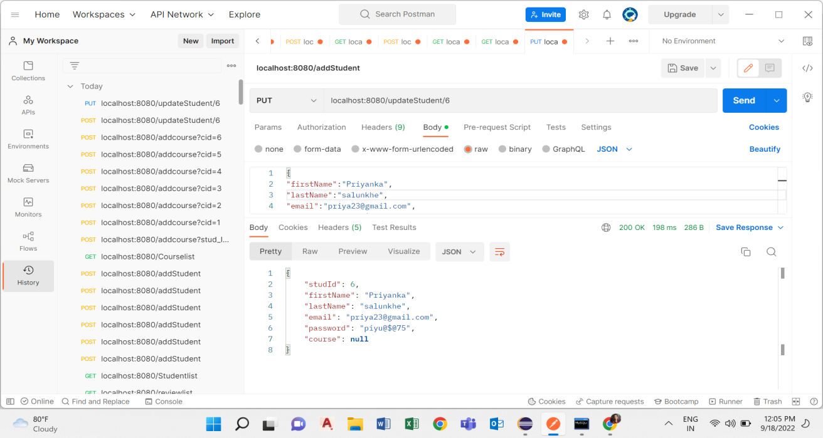
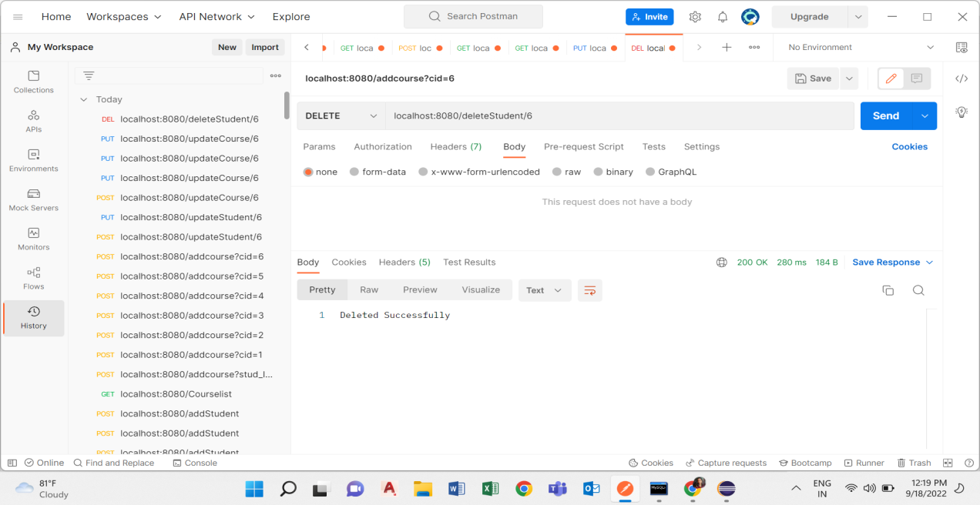
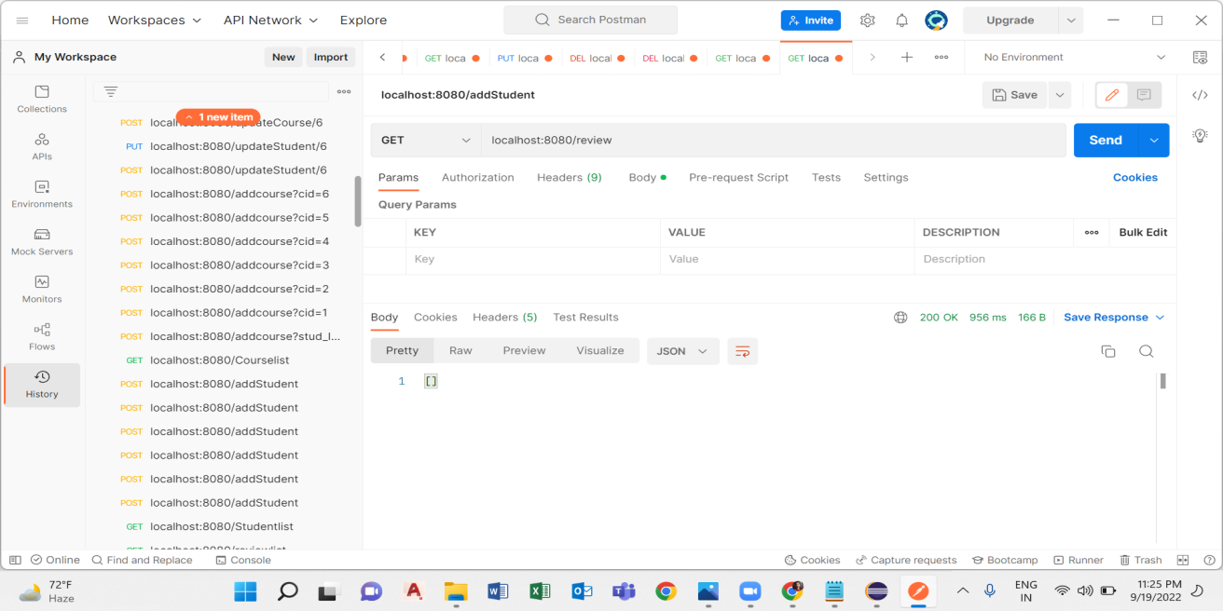

Slide 15
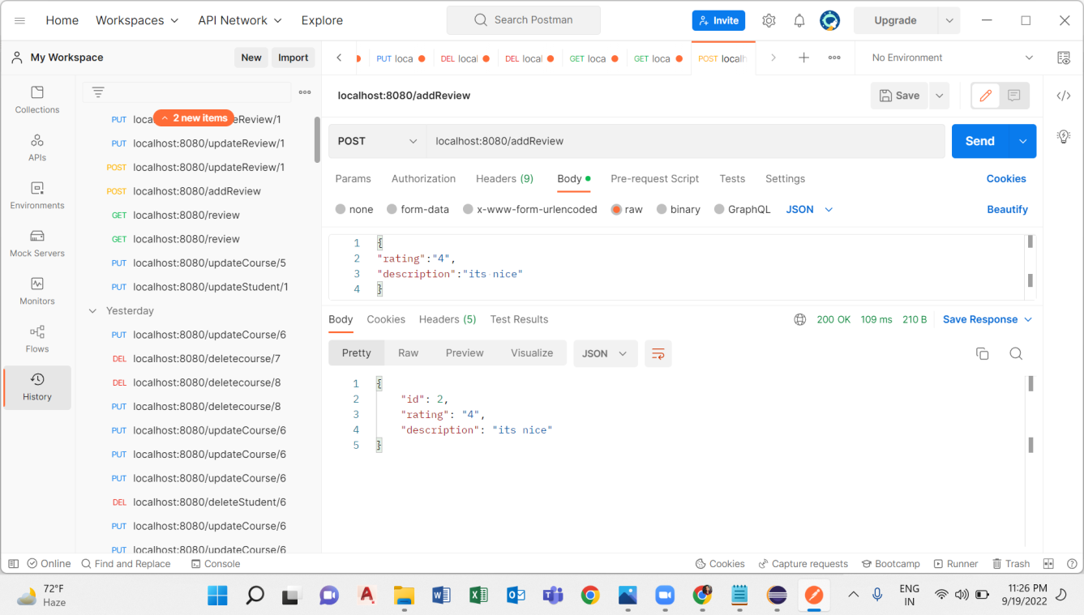
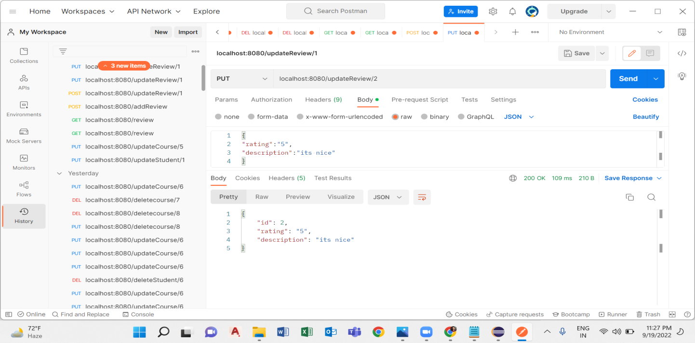


Slide 16
ADVANTAGES
It provides better and efficient services.
Provide facility for proper monitoring, reduce paper work and provide data security.
Faster way to get information about the student.

Slide 17
CONCLUSION
It was a wonderful and learning experience for us while working on this project.
This software is very easy to use so all educational institute can use this frequently.
So, we can hope that our software will be very popular and get sponsors to develop in future.

Slide 18
THANK YOU

